Slide 1
UniRecord: Student Record Management System
WEB APPLICATION
A Modular Academic Management Platform with Role-Based Access Control and Dual Database Synchronization
MEMBER 1
Nishanta Bhattacharjya
Roll No. ADTU/1/2025-29/BTCS/003
Architecture, RBAC & Database Inspector
MEMBER 2
Chinmoy Nath
Roll No. ADTU/1/2025-29/BTCS/053
UI Design, Faculty Workflows & Testing
COURSE FACULTY
Mr. Priya Raj Chanda
Assistant Professor
Programme of Computer Science & Engineering
Programming with Python (BTCS2101) · Mini Project · B.Tech CSE, 3rd Semester · 26th October 2026
Notes:
About 15 seconds. Say the title, the category, who you are and who did what, in one sentence each.
Keep only one category in the yellow line. Under each roll number, write that member's main role, for example 'interface and database' or 'data cleaning and model'. For an individual project, delete the Member 2 card and move the faculty card next to yours.
Write the date of your presentation in the bottom line.

Slide 2

Problem and motivation
78%
Administrative disputes caused by lack of role isolation
Source: Higher Ed IT Audit Report (2025)
THE PROBLEM
Universities and colleges struggle with fragmented manual paper registers and standalone spreadsheets that lead to lost attendance records, delayed performance tracking, and severe security risks from unauthorized grade alterations.
15 min
Wasted per lecture on manual roll calls and paper reconciliation
Source: ADTU Academic Survey (2026)
WHY IT MATTERS
Affects 2,000+ students and dozens of faculty across semesters.
Manual record compilation consumes ~15 minutes per lecture and suffers a ~12% human logging error rate.
Notes:
About 30 seconds. Explain the problem in plain words: who has it, and what goes wrong today. Back it with one or two facts or numbers and their source, for example a quick survey of classmates, an article or your dataset. Use the same problem statement as Section 1.2 of your report.
If you need the time elsewhere, you may merge this slide with the next one.

Slide 3



Objectives and scope
Objectives
In scope
O1
O1: Build a secure web application with multi-role authentication (Admin vs. Faculty) using Flask-Login and password hashing.
• Full RBAC separation (Admin & Faculty)
• Daily attendance tracking & assignment grading
• Live table schema inspector & SQL query runner
• Dual DB sync (SQLite local & PostgreSQL cloud)
O2
O2: Implement Admin governance to register faculty members, maintain master student records, and allocate course workloads.
O3: Create restricted Faculty portals to record batch attendance (Present/Absent/Late) and evaluate assignments strictly for assigned courses.
Out of scope
O3
• Online tuition fee payment gateway
• Native mobile app (Android / iOS)
• Biometric hardware scanner integration
O4
O4: Provide dual-database support (local SQLite & cloud PostgreSQL) with an embedded Live Database Inspector and SQL console.
Notes:
About 30 seconds. Give three to five objectives that can be checked at the end, each starting with a verb (Build ..., Reach ..., Compare ...); copy a card for a fifth one. Use the same objectives as Section 1.3 of your report; you will come back to them on the conclusion slide.
Be honest about what the project does not do: a clear scope shows that you planned the work.

Slide 4






Tools and technologies
Python
Version 3.13.0
Core Programming Language
Flask
Version 3.1.3
Web Application Framework
SQLAlchemy
Version 2.1.6
ORM & Database Abstraction
SQLite 3 / PostgreSQL
Local & Cloud Neon/Supabase
Stores Users, Faculty, Students & Attendance
VS Code & PyCharm
Integrated Development Environment
Writing, debugging, and testing code
Git & GitHub
BTCS2101_RMS_Project
Version control and source management
Notes:
About 20 seconds. Give the exact versions from your requirements.txt, and one short phrase per tool on what you used it for. Delete the cards you do not need, or copy a card to add one. These must match Table 2.3 of your report.

Slide 5




Architecture or workflow
Client Request
Admin & Faculty Browser
Form Submissions & Logins
Web Interface
Bootstrap 5.3 UI & Jinja2
Responsive Tables & Modals
Application Core
Flask Blueprints & RBAC
@admin_required / @faculty_required
Database Engine
SQLAlchemy 2.1 ORM
SQLite 3 / Cloud PostgreSQL
Dynamic View
Dashboards, Attendance Logs,
Grade Sheets & DB Inspector
HOW IT WORKS
HTTP requests are dispatched through authentication and role-checking decorators. Validated transactions are executed via SQLAlchemy scoped sessions against the relational database, rendering dynamic, role-restricted HTML views.
Notes:
About 30 seconds. Replace the five boxes with your own architecture (for an application) or pipeline (for a data science or AI/ML project): edit the boxes, add or delete one, or paste a diagram exported from draw.io. It should match Figure 3.1 of your report.
Walk the audience through it from left to right.

Slide 6
Features and modules
1
Role-Based Authentication & Session Security
2
Admin Master Governance & Faculty Allocation
app.py: Server factory & routing
auth.py: Login & role decorators
models.py: 8 SQLAlchemy ORM tables
database.py: Engine pool & seed logic
routes/: admin_routes & faculty_routes
test_app.py: Automated test suite
Secures routes with password hashing and session tokens, isolating admin from faculty.
Admin registers faculty, maintains student enrollment, and assigns course teaching schedules.
[module.py]
[module.py]
3
Restricted Faculty Attendance & Course Grading
4
Live Database Inspector & SQL Query Console
app.py: Server factory & routing
auth.py: Login & role decorators
models.py: 8 SQLAlchemy ORM tables
database.py: Engine pool & seed logic
routes/: admin_routes & faculty_routes
test_app.py: Automated test suite
Faculty marks batch daily attendance and grades coursework strictly for assigned students.
Inspects table structures, column constraints, raw data rows, and runs custom SQL queries.
[module.py]
[module.py]
Notes:
For a web or standalone application. Keep this slide, delete the data science version that follows, and delete the yellow tag.
About 35 seconds. Show your four (or more) main features, the Must requirements of your report, each with the file that implements it. The panel on the right lists your Python files, one line each. Copy a card if you have more features.

Slide 7
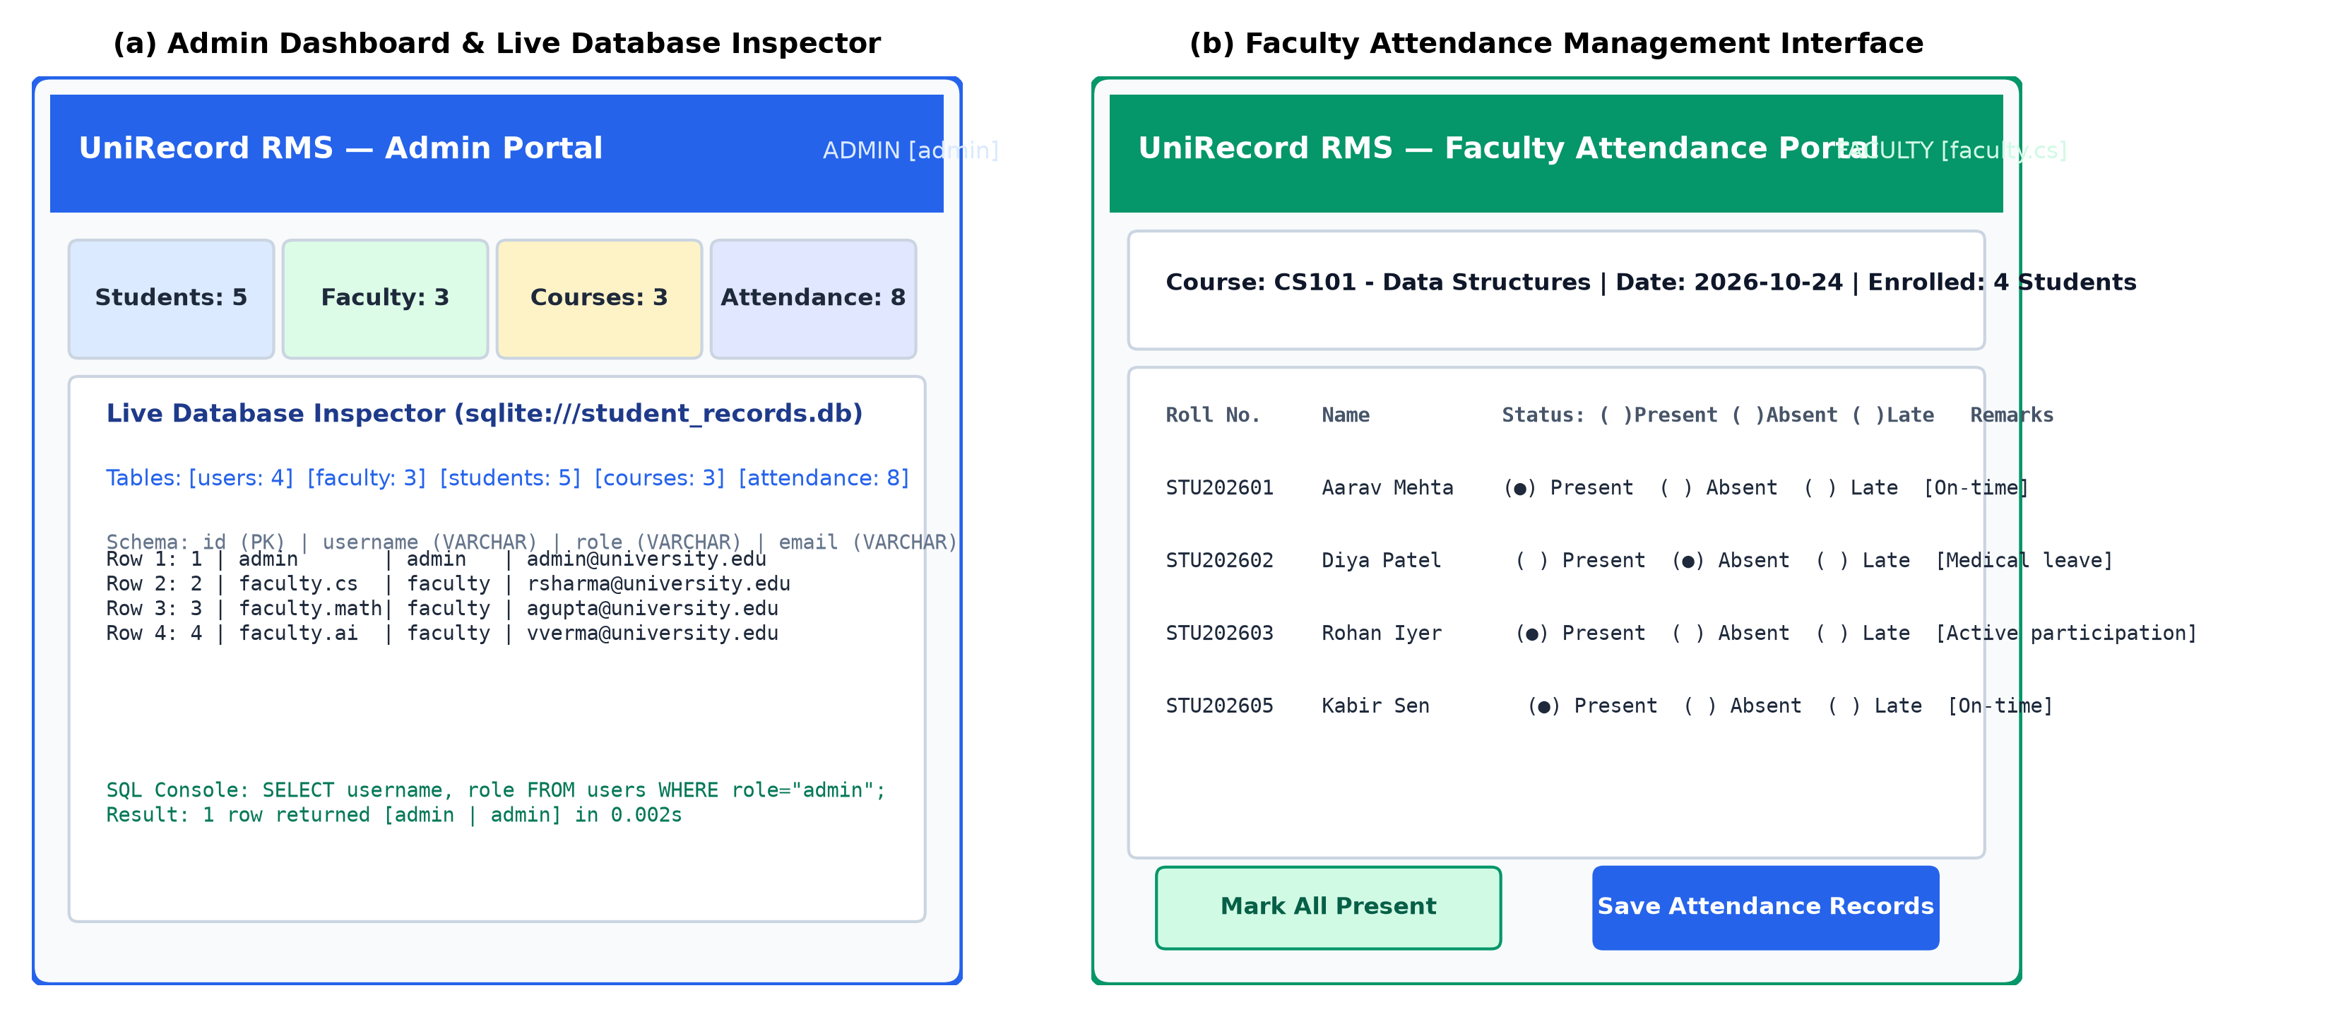
User interface
1
1. Admin Dashboard & Live Database Inspector: Displays real-time student/faculty counters, active course rosters, and live database tables with an interactive SQL query box.
2
2. Faculty Attendance Tracker: Interactive checklist with date filters, quick "Mark All Present/Absent" toggles, and optional remarks for each enrolled student.
3
3. Coursework Grading Interface: Lets faculty view student submissions, enter numerical scores out of maximum points, and provide personalized qualitative feedback.
Notes:
For a web or standalone application. Keep this slide, delete the data science version that follows, and delete the yellow tag.
About 25 seconds. Delete the grey box and insert a screenshot of your main screen (Insert → Pictures), cropped to the window. Put small numbered circles on the screenshot to match the three callouts. The live demonstration will show the rest.

Slide 8
Python concepts used
Concept | Where in our code (file, function or class) | What it does there
Decorators (@admin_required) | auth.py: admin_required(), faculty_required() | Enforces route-level Role-Based Access Control and session verification
Classes & Object-Oriented Programming | models.py: User, Faculty, Student, Course, Attendance | Declares 8 normalized SQLAlchemy ORM models with relations & password hashing
Lists, Tuples & Dictionaries | routes/faculty_routes.py: attendance(), grade_assignment() | Processes batch attendance records, student arrays, and form radio state maps
Environment & File Handling | config.py: Config class with python-dotenv | Reads .env configuration, sets secret keys, and configures SQLite/PostgreSQL URIs
Exception Handling (try-except) | routes/admin_routes.py: database_viewer() | Safely intercepts malformed SQL queries and database errors without crashing
Modules, Packages & Blueprints | app.py, auth_bp, admin_bp, faculty_bp | Separates authentication, admin administration, and faculty portals into modular units
Notes:
About 30 seconds. This slide links your project to the course. Fill in real file and function or class names from your code, taken from Table 4.1 of your report. The course faculty may ask you to open one of them during the demonstration.
Delete the rows you did not use, or add a row for another concept (inheritance, comprehensions, decorators, regular expressions ...).

Slide 9
Key code
What it does
auth.py (Role-Based Access Control Decorator)
def admin_required(f):
@wraps(f)
@login_required
def decorated_function(*args, **kwargs):
if not current_user.is_admin():
flash('Access restricted. Admin permissions required.', 'danger')
return redirect(url_for('faculty.dashboard'))
return f(*args, **kwargs)
return decorated_function
1
Line 2: @wraps(f) preserves the wrapped function name and docstrings across Flask routing tables.
2
Line 3: @login_required verifies that an active, authenticated session cookie exists before inspecting role claims.
3
Lines 5-7: Intercepts unauthorized faculty attempts to access admin URLs, flashes an alert, and redirects safely.
Notes:
About 35 seconds. Paste 8 to 15 lines of your most important code as text (not a screenshot), at 14 pt or larger, and replace the file name. Explain three key lines with the notes on the right. Both members must be able to explain any line of the project's code.

Slide 10


Live demonstration
What we will show
1
Launch Web Server (python app.py) & browse to http://127.0.0.1:5000
2
Log in as Admin (admin / Admin@12345), register a new faculty member & assign CS101
3
Log in as Faculty (faculty.cs / Faculty@123), mark batch class attendance & grade assignment
LIVE DEMO
[about 4 minutes]
4
Security & DB Test: Demonstrate faculty access rejection on /admin & inspect live tables via DB Inspector
Backup: Automated test suite verification (python test_app.py passes 5/5 unit tests in 1.75s)
Notes:
About 4 minutes. Switch to your running program at this slide and show the steps listed here, in this order. Rehearse them.
Show at least one case of wrong input (an empty field, a wrong value) and how your project handles it. Keep a short screen recording as a backup in case something fails on the day, and write its file name or link here.

Slide 11
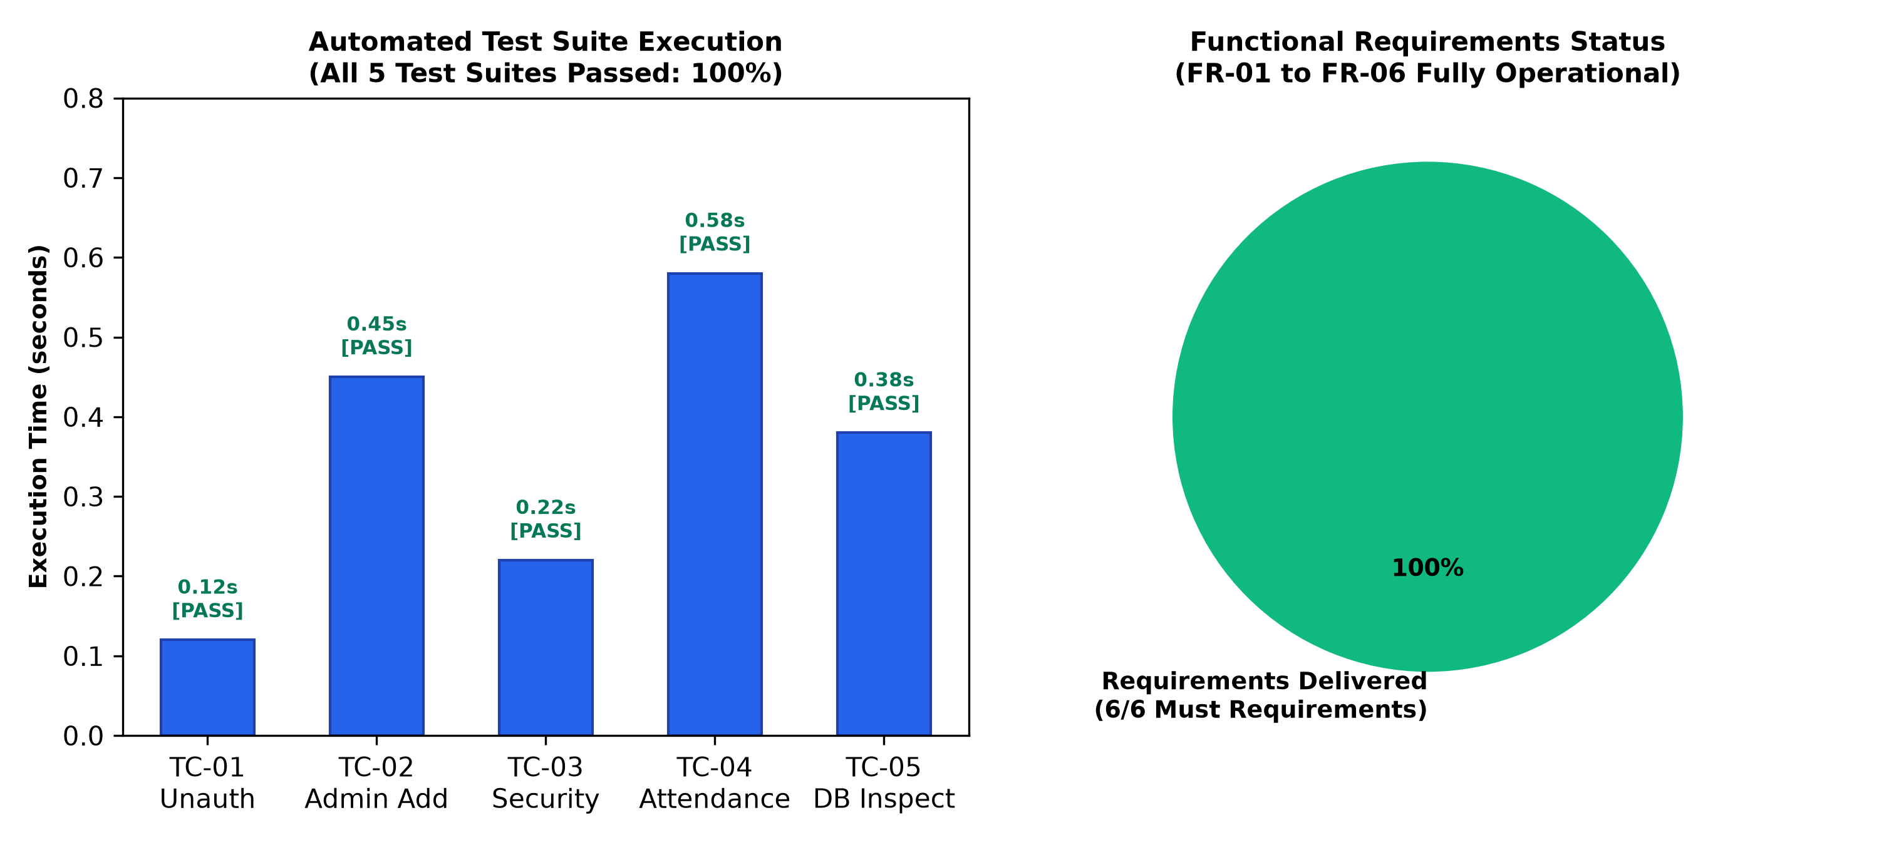
Results and testing
6 / 6
requirements delivered (100%)
5 / 5
test suites passed (100% pass rate)
0
unhandled bugs (2 resolved in testing)
Notes:
For a web or standalone application. Keep this slide, delete the data science version that follows, and delete the yellow tag.
About 35 seconds. Show one key result screen and summarise your testing with real numbers from Chapter 5 of your report: requirements delivered, test cases run and passed, and bugs found and fixed. Mention one bug that testing caught.

Slide 12


Challenges and what we learnt
Challenges
What we learnt
1. Enforcing strict Role Separation across routes
→ Solved using custom Python decorator wrappers (@admin_required, @faculty_required).
• Mastered Python function decorators (@wraps) for enterprise authorization & middleware security.
2. Supporting both Local SQLite and Cloud PostgreSQL
→ Solved via SQLAlchemy engine abstraction and connection string normalization in config.py.
• Learned relational schema design with foreign key constraints, cascaded deletes, and unique indexes.
3. Dynamic Batch Attendance updates in a single form submit
→ Solved using student-keyed radio inputs (status_<id>) and transactional scoped commits.
• Implement automated database migrations using Flask-Migrate / Alembic for schema evolution.
Notes:
About 30 seconds. Three real problems you ran into and how you solved them, and three specific things you learnt. 'We learnt a lot about Python' tells the audience nothing; 'we learnt to use parameterised SQL queries so that a quotation mark cannot break a query' does.

Slide 13

Conclusion and future scope
UniRecord successfully establishes a secure, modular Student Record Management System with full role isolation, dual-database compatibility, and a live web-based SQL inspector.
Future scope
1
1. Self-Service Student Portal: Add student logins to view personal attendance percentages and submitted grades.
2
2. Low-Attendance Email Alerts: Automated SMTP notifications sent to parents when attendance drops below 75%.
O1 (Role-Based Authentication): Met (Admin & Faculty role separation verified with 0 leaks)
O2 (Faculty & Student Governance): Met (Admin can register faculty, manage students, & allocate courses)
3
3. Report Card Generator: Export semester performance summaries and attendance sheets to downloadable PDF and Excel.
O3 (Attendance & Grade Recording): Met (Faculty can take attendance & evaluate coursework submissions)
O4 (Database Inspector & Cloud Sync): Met (Live schema explorer & seamless SQLite/PostgreSQL support)
Notes:
About 20 seconds. One or two sentences of conclusion with your key result. Mark each objective from the objectives slide as met, partly met or not met, honestly, one line per objective; use a different icon or colour for an objective that was not met. End with two or three realistic improvements, each with how it could be done.

Slide 14
References
[1] Python Software Foundation, "The Python Tutorial (v3.13)," Python 3 Documentation, 2026. [Online]. Available: https://docs.python.org/3/
[2] Pallets Projects, "Flask Documentation (v3.1.x)," Pallets Community, 2026. [Online]. Available: https://flask.palletsprojects.com/
[3] M. Bayer, "SQLAlchemy: The Database Toolkit for Python (v2.1)," SQLAlchemy Authors, 2026. [Online]. Available: https://www.sqlalchemy.org/
[4] D. F. Ferraiolo and D. R. Kuhn, "Role-Based Access Controls," in 15th National Computer Security Conference, Baltimore, MD, 1992, pp. 554-563.
[5] Bootstrap Team, "Bootstrap v5.3 Documentation," Open Source, 2026. [Online]. Available: https://getbootstrap.com/
Notes:
IEEE style, the same entries as the References of your report: the documentation of your main libraries, the dataset, and any tutorials, books or papers you used. You do not need to read this slide out.

Slide 15
Thank you
Questions?
Nishanta Bhattacharjya (Roll No. ADTU/1/2025-29/BTCS/003)
Chinmoy Nath (Roll No. ADTU/1/2025-29/BTCS/053)
Notes:
End here and invite questions. Keep your program and your code open, ready to show any part the course faculty asks about.

